Slide 1

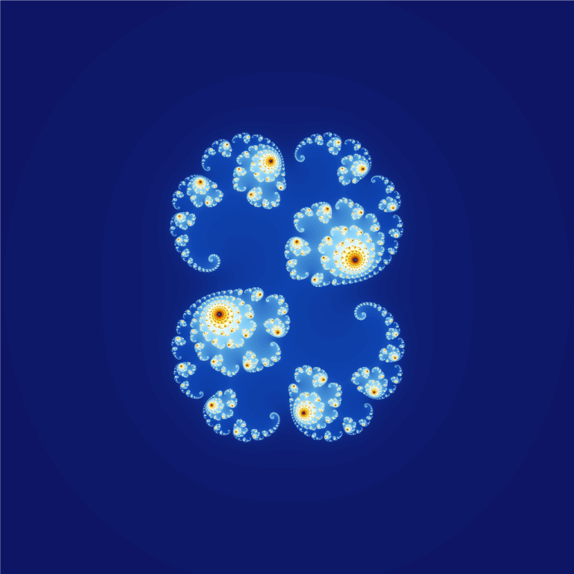
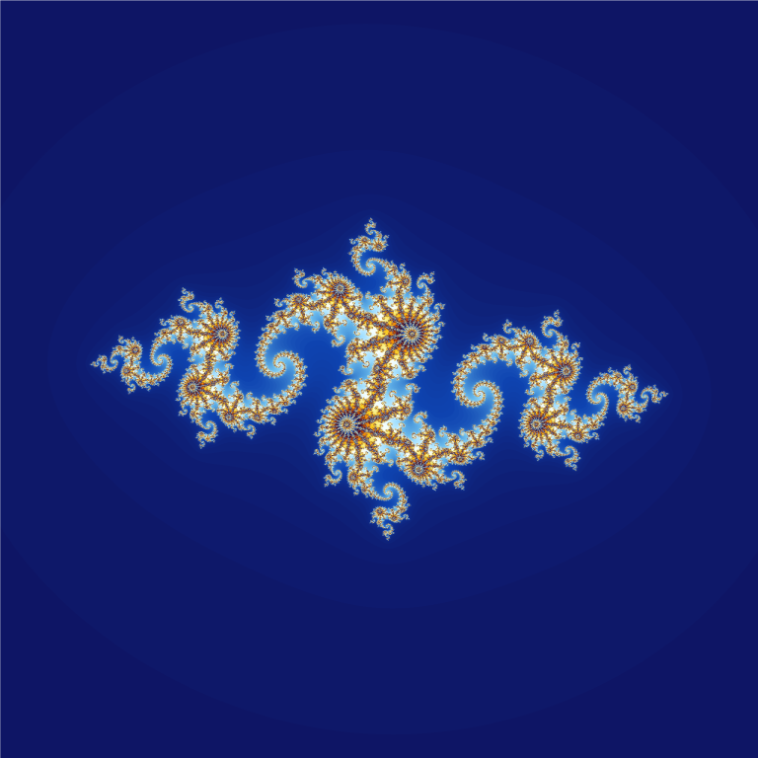
Julia Sets
In the complex plane:
Choose any Julia constant (a,b) (such that a² + b² < 4)
Now for each point z = (x, y) in the complex plane
Iterate the computation:
z = z² + (a, b)
which simplifies to:
z = (x, y)*(x, y) + (a, b)
= (x+iy)*(x+iy) + (a, b)
= x² + 2xiy – y² + (a, b)
= (x² + 2xiy – y², 2xy) + (a, b)
= (x² – y² + a, 2xy + b) (use this in the code)
if z GROWS to be outside the circle of radius 2 centered at (0,0)
then the point (x,y) is NOT in the Julia set
& pixel color based on ITERATIONS to ESCAPE circle
If z STAYS inside the circle
then the point (x,y) is IN the Julia set
& pixel colored is BLACK
imaginary axis
y
z=x+iy
real
axis
x

Slide 2

1
The Mandelbrot Set
+
+
+
-1
.5
-1
+

Slide 3
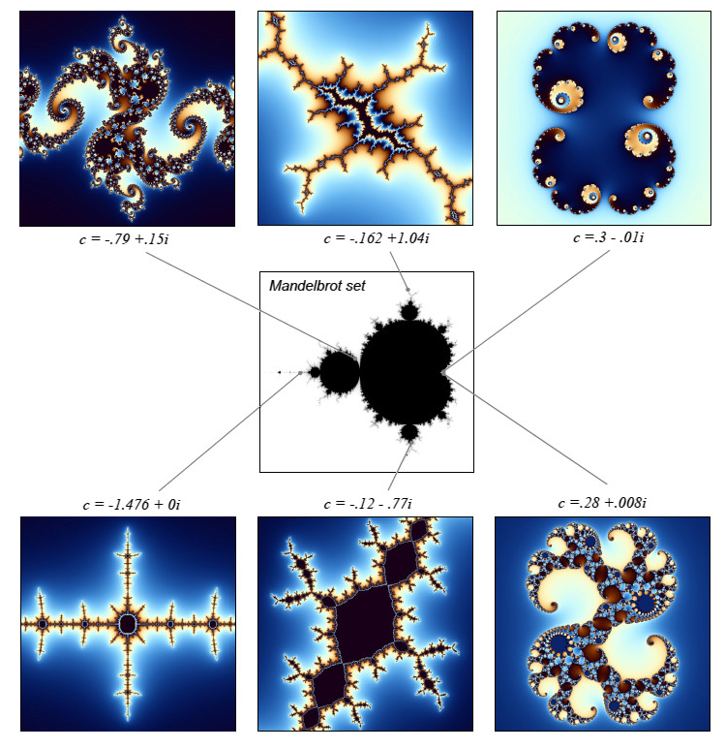
1
+
Julia set with constant
c = (-.162, 1.04)
+
+
-1
.5
Julia set with constant
c = (-1.476, 0)
-1
+

Slide 4
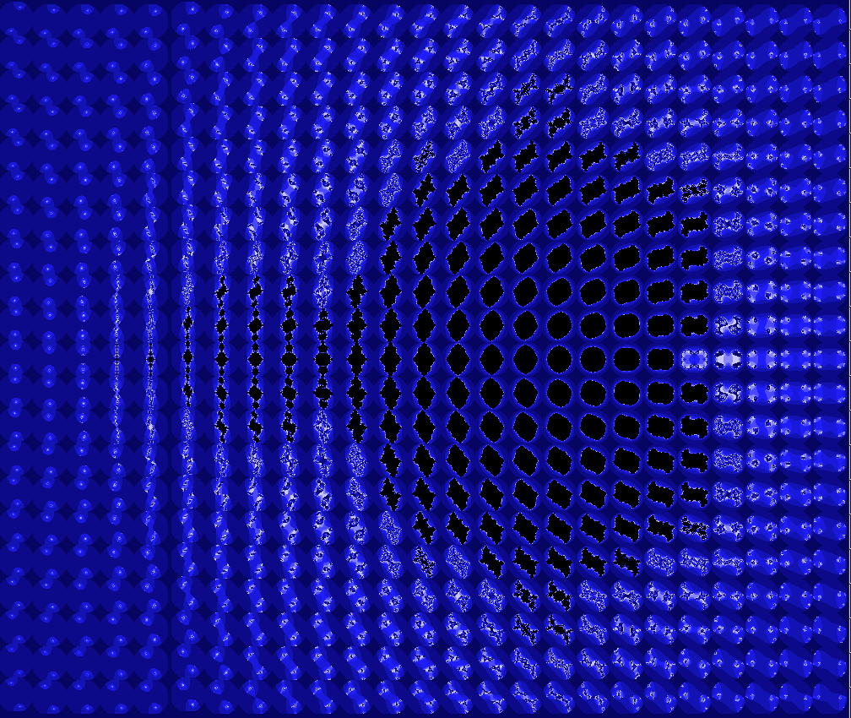
Julia Set Map

